Slide 1
ADLTM: A Topic Model for Discovery of Activities of Daily Living in a Smart Home Yu Chen, Tom Diethe, Peter Flach Department of Computer Science, University of Bristol, United Kingdom Conference - Proceedings of the Twenty-Fifth International Joint Conference on Artificial Intelligence (IJCAI-16)
Presented By – Ankush Israney
Date of Presentation – 03/16/2017

Slide 2
Goals and Motivation
To be able to automatically recognize activities of Daily Living
Varied Applications in Improved daily living:
Assistive Applications for elderly people.
Monitor Actions for lifestyle change.
Three Main Sources of Information:
Video Streams – Vision Community / Demonstration by Learning
Wearable Sensors – Vision Community (Deep Learning gaining popularity)
Environmental Sensors (Temperature sensors, pressure sensors, light switches etc.)
Cheap and Easy to Set up
Lesser Privacy Concerns.

Slide 3
Activity Recognition is a Hard Problem
Multiple Activities & Instances of the Same Activity Class
Interleaved Activities
Multiple Ways/Actions to Achieve Goals (Uncertainty)
Difficult to Define Goals for Intentions (example : Cleaning)
Different Communities to Solve this Problem:
Plan Recognition
Libraries of Plans
Logic Programming (Hybrid, Ontologies etc)
Careful Domain Knowledge & Engineering
Supervised Learning
Time Consuming & Error Prone Labelling
Unable to Recognize Unseen Activities.
Unsupervised Learning
Lesser Accuracy on Datasets compared to Supervised Learning
Flexibility to Capture Exceptions in realistic scenarios

Slide 4
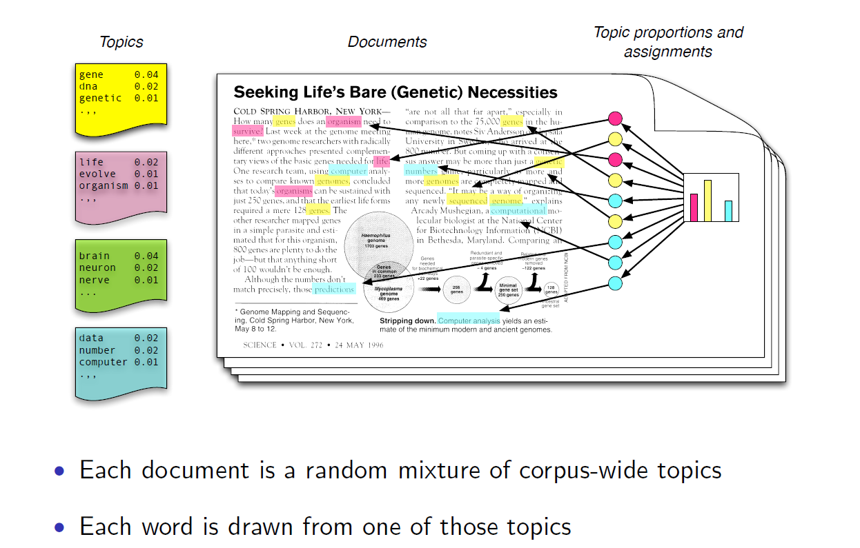
Topic Modelling, The Generative Model: David M. Blei, MLSS, September 2009,
http://videolectures.net/site/normal_dl/tag=50740/mlss09uk_blei_tm.pdf

Slide 5
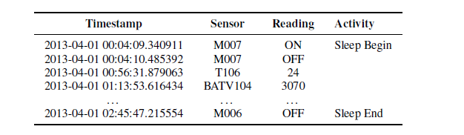
Sample Dataset and Definition of Words
CASAS Project Datasets: Popular Datasets for Activity Recognition
Unigrams and Bigram Words
Documents are collection of Spatially Correlated words

Slide 6
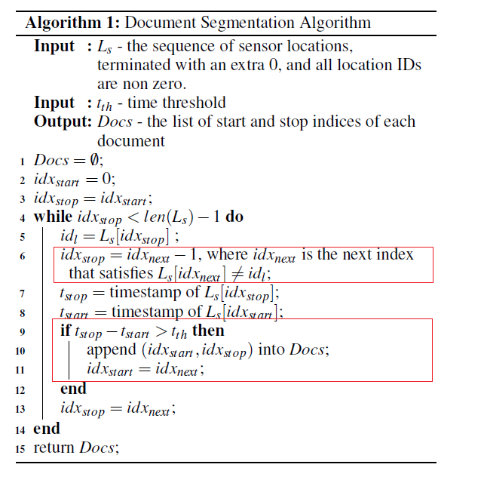
Document Segmentation Algorithm : Contribution 1
Change of Location is Strong Indication for Segmentation
Threshold has a role to play in Segmentation Error
Online Version is suggested to include second Threshold for Maximum duration of Document

Slide 7
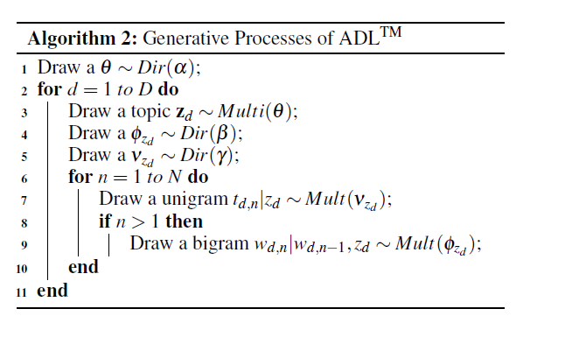
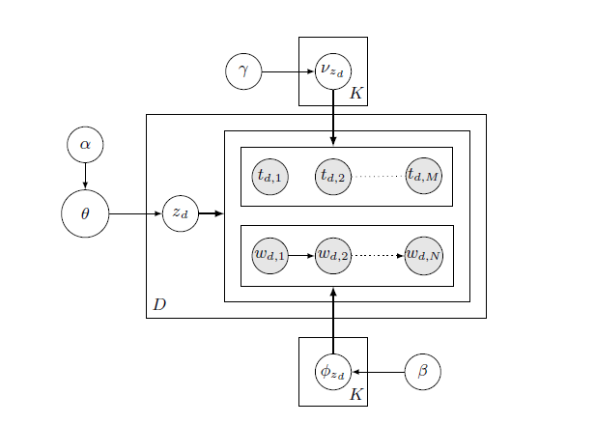
Generative Process and Plate Notation:

Slide 8
Difference between LDA and ADL
Contribution 2:
Topics drawn for documents rather than words
Different Vocabularies for Unigram and Bigram Sequences
Markov Chain for Bigrams
(affects size of vocabulary for phi)

Slide 9


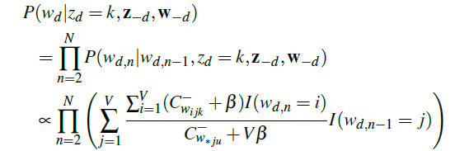
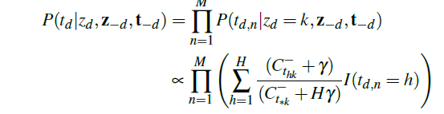
Gibbs Sampling of ADL

Slide 10
Hyperparameters and Interpreting Counts
Topic prior: alpha = 50/K
Bigram and unigram priors: beta = 5/V, gamma = 5/H.
Contribution 3: Interpretation of Counts
Unigram counts are counted by term frequency
Bigram counts are counted by document frequency (Avoid Self Transitions)

Slide 11
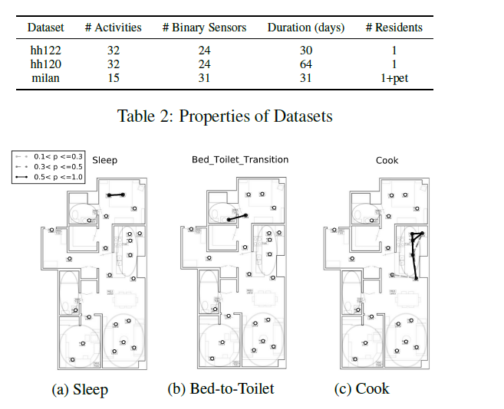
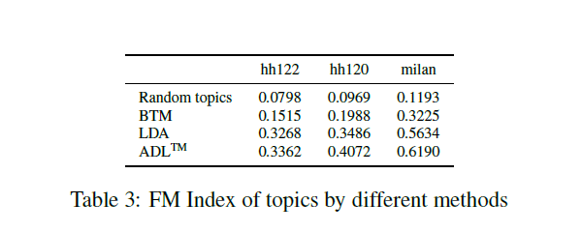
Evaluation

Slide 12

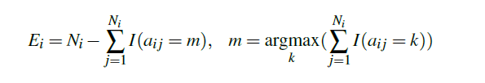

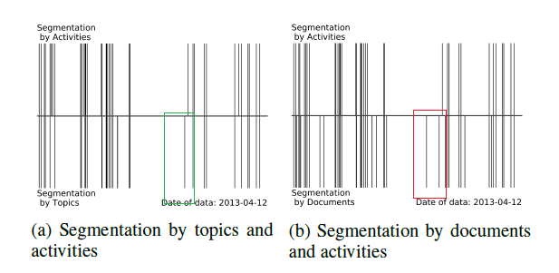
Segmentation and it’s Metrics
Segmentation Error: Average Error over all Segments
Fragment Ratio: Average number of segments in one occurrence of an activity

Slide 13
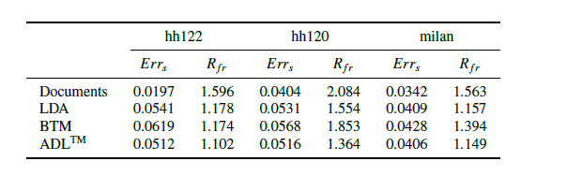
Segmentation Results
Effects of Threshold th:
Smaller = higher fragment ratio + low segmentation error
Larger = higher segmentation ratio + lower fragment error

Slide 14
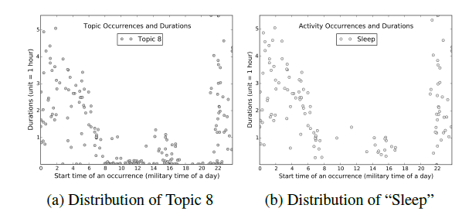
Applications
dataset hh122 compression
129936 to 2792 data points.
Detection of Sleep Patterns
Average duration: 7.02 hours)

Slide 15
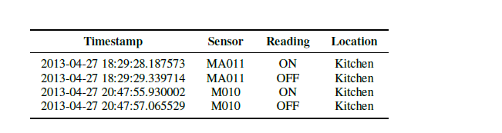
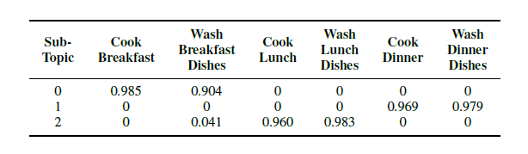
Applications : Continued
Combination with Other Distributions
(Use of Sleep + Restroom)
Subtopic Clustering
K-means with K explicitly = 3
Columns don’t sum to 1
Detection of Outliers
Deploy z-scores on duration of data-points

Slide 16
Answers to Questions
What do the authors claim is the contribution of the paper?
Segmentation Algorithms (Document Generation + Topic Segmentation)
ADL outperforms LDA and BTM (Novel Unsupervised Approach, powerful topic model)
2) What is the actual contribution of the paper?
Segmentation Algorithms:
Document Generation due to spatial correlation
Don’t give many details on criterion to segment/integrate topics from documents
ADL outperforms LDA and BTM
Not Novel with respect to LDA (Use Case of LDA/hierarchical Bayesian inference)
Topic Distribution for Documents - insight into the domain
Interpretation of Counts in Unigram and Bigrams - insight into approximation for domain
Markov Chain for Bigrams
Detailed Evaluation in terms of Applicability (example, Detect outliers for instance)

Slide 17
Answers to Questions : Continued
3) Are the results of the paper replicable?
May be not (No source code – probably proprietary work) :
Document Segmentation Algorithm given (threshold calculation is not)
4) Are there significant technical faults in the paper or open cases that are not addressed?
Not Any Significant faults but some Strong Assumptions and minor issues
Assumption 1: Environmental Sensors reflect actions of humans and their Activities.
Assumption 2: Evaluation for 1 resident
Minor issue: 50 iterations for gibbs Sampling

Slide 18
Answers to Questions : Continued
5) What is the next incremental step in this research?
Simultaneously Categorizing by Spatial and Temporal Dimensions
Online Variational Inference Algorithm (Standard LDA)
Prior knowledge for hyperparameters: alpha, beta and gamma
Semi-Supervised Learning
Correlations in topics introduced in the model

Slide 19
Answers to Questions : Continued
6) What is the next long term step in this research program?
Future Systems are to follow Complex, hybrid Architectures
Evaluate formally (Quantitively and qualitatively) the true advantage of this against other methods (Deep Learning? Extend in Bayesian Nonparametrics?)
Reason about motions of Humans, properties of objects (Fall Back to Video Streams)
Privacy-Preserving Human Activity Recognition from Extreme Low Resolution:
Michael S. Ryoo 1;2, Brandon Rothrock, Charles Fleming, Hyeon Jong Yang (AAAI 2017)

Slide 20
Questions and Discussion

